Slide 1
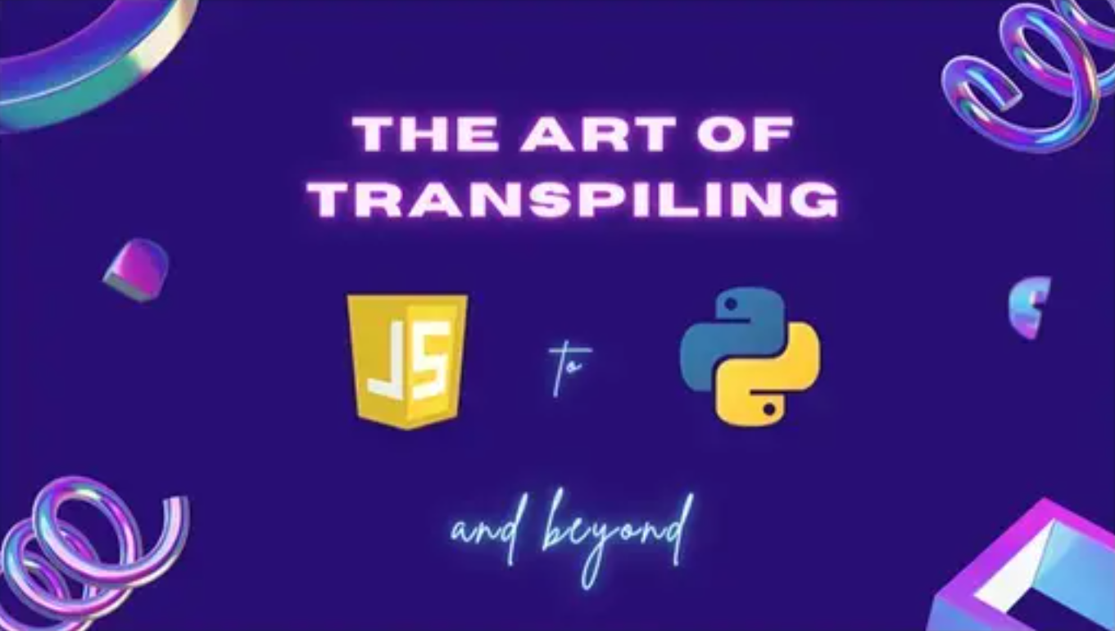

Slide 2


Slide 3



Our Sponsors

Slide 4





swflcoders.slack.com
Notes:
Coders Slack channels: Hiring looking, today I learned, presentations, new programmers

Slide 5








TECH ALLIANCE OF SWFL
www.meetup.com/TechAlliance-SWFL

Slide 6





SWFL Tech
WordPress Meetup Southwest Florida
Other Tech Groups in SWFL
OWASP Bonita Springs

Slide 7
Events
PySWFL: NAND to Tetris Study Group Mon July 18 - Online @ 6:30 pm
SWFLSec: Breaking into Cybersecurity w/ Satch Wed July 20 - Online @ 6:30 pm
Tech Alliance of SWFL: State of the Metaverse in 2022 Thu July 21 - Collaboratory (Hybrid) @ 6:30 pm
PyLadies: The Art of Transpiling Thu July 28 - Collaboratory (Hybrid) @ 6:30 pm
SWFLSec: Social Event Wed Aug 3 - Hopsized Brewing Company @ 6:00 pm
SWFL Tech Nights: The United Certificate Path Tues Aug 9 - Online @ 6:00 pm
SWFL Coders: Intro to Web Development Thu Aug 11 - Collaboratory (Hybrid) @ 6:30 pm
VR & AR of SWFL: Showcase of Southwest Florida Thu Sept 1 - Collaboratory @ 6:30 pm

Slide 8

Tell Us Your Needs

Slide 9


The Art of Transpiling: JS to Python and Beyond
👨🏻‍💻 Jon Boynton

Slide 10


Slide 11





Slide 13
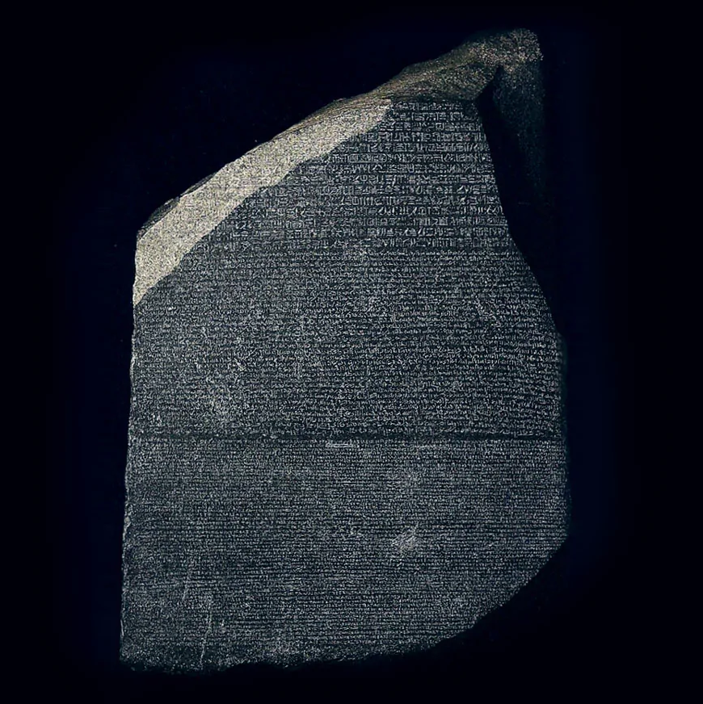

Slide 14

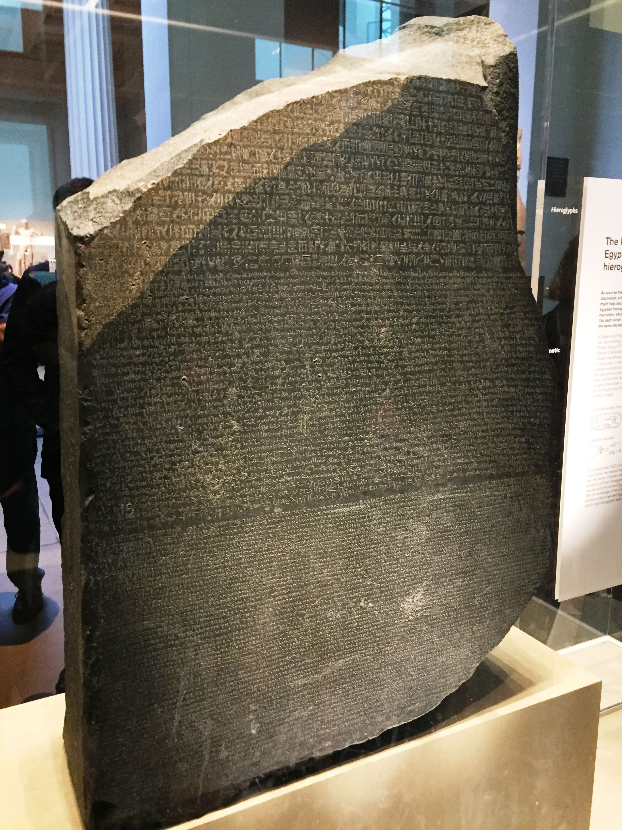

Slide 18
What Is Transpiling ?

Slide 19
What Is Transpiling ?

Slide 20
What Is Transpiling ?
Compiling

Slide 21
What Is Transpiling ?
Compiling
Transcoding

Slide 22
What Is Transpiling ?
Compiling
Translating
Transcoding

Slide 23
What Is Transpiling ?
Compiling
Translating
Transcoding

Slide 24
Transpiling:
Translating source code between programming languages that operate at approximately the same level of abstraction.

Slide 25
Why Do We Do it ?

Slide 26
Why Do We Do it ?

Slide 27
Reasons for Transpiling
Compatibility
Extendibility
Reusability
Reliability

Slide 28
Reasons for Transpiling
Compatibility
Extendibility
Reusability
Reliability

Slide 29
Reasons for Transpiling
Compatibility
Extendibility
Reusability
Reliability

Slide 30
Reasons for Transpiling
Compatibility
Extendibility
Reusability
Reliability

Slide 31
Reasons for Transpiling
Compatibility
Extendibility
Reusability
Reliability

Slide 32
Reasons for Transpiling
Compatibility
Extendibility
Reusability
Reliability

Slide 33
Is all transpiling the same?

Slide 34
Is all transpiling the same?

Slide 35
Transpiling Priorities
Machine Interpretability
Human Interpretability

Slide 36
Transpiling Priorities
Machine Interpretability
Human Interpretability

Slide 37
Transpiling Priorities
Machine Interpretability
Human Interpretability

Slide 38
Transpiling Priorities
Machine Interpretability
Human Interpretability

Slide 39
How Do We Do it?

Slide 40
i = expression

Slide 41
i = expression
i = 1 + 2

Slide 42
i = expression
i = 1 + 2
i = "string1" + "string2"

Slide 43
i = expression
i = 1 + 2
i = "string1" + "string2"
i = "string1" + 2

Slide 44
Breaking
Breaking down a language into abstract categories

Slide 45
Breaking down a language into abstract categories

Slide 46
Common abstract categories:

Slide 47
Common abstract categories:
Syntax
Operators
Keywords
Features
Libraries

Slide 48
Syntax

Slide 49
Syntax

Slide 50
Syntax :
“set of rules that define the combinations of symbols that are considered to be correctly structured statements or expressions…”
Source: Wikipedia.org

Slide 51
Syntax :
“set of rules that define the combinations of symbols that are considered to be correctly structured statements or expressions…”
Source: Wikipedia.org

Slide 52
Syntax :
Stuff that uses these things:
", ( ), { }, [ ], ;, : , \n, \t
Source: Wikipedia.org

Slide 53
Syntax :
Stuff that uses these things:
", ( ), { }, [ ], ;, : , \n, \t
Source: Wikipedia.org

Slide 54
Syntax :
Create blocks of code (conditions, loops, classes, functions)
define statements
declare variables
instantiate objects
separate values and conditions

Slide 55
Operators :
Symbol that represents an action or process

Slide 56
Operators :
Symbol that represents an action or process

Slide 57
Operators :
Assignment (=, +=…)
Arithmetic (+, -, /, *, %...)
Boolean (&&, ||, !)
Relational (<, > , ==…)
Bitwise (&, |, ^, ~)

Slide 58
Operators :
Assignment (=, +=…)
Arithmetic (+, -, /, *, %...)
Boolean (&&, ||, !)
Relational (<, > , ==…)
Bitwise (&, |, ^, ~)

Slide 59
Keywords :
Words reserved by a language for a specific purpose

Slide 60
Keywords :
Words reserved by a language for a specific purpose

Slide 61
Keywords :
Javascript
Python
abstract arguments await boolean
break byte case catch
char class const continue
debugger default delete do
double else enum eval
export extends false final
finally float for function
goto if implements import
in instanceof int interface
let long native new
null package private protected
public return short static
super switch synchronized this
throw throws transient true
try typeof var void
volatile while with yield
False None True and
as assert async await
break class continue def
del elif else except
finally for from global
if import in is
lambda nonlocal not or
pass raise return try
while with yield

Slide 62
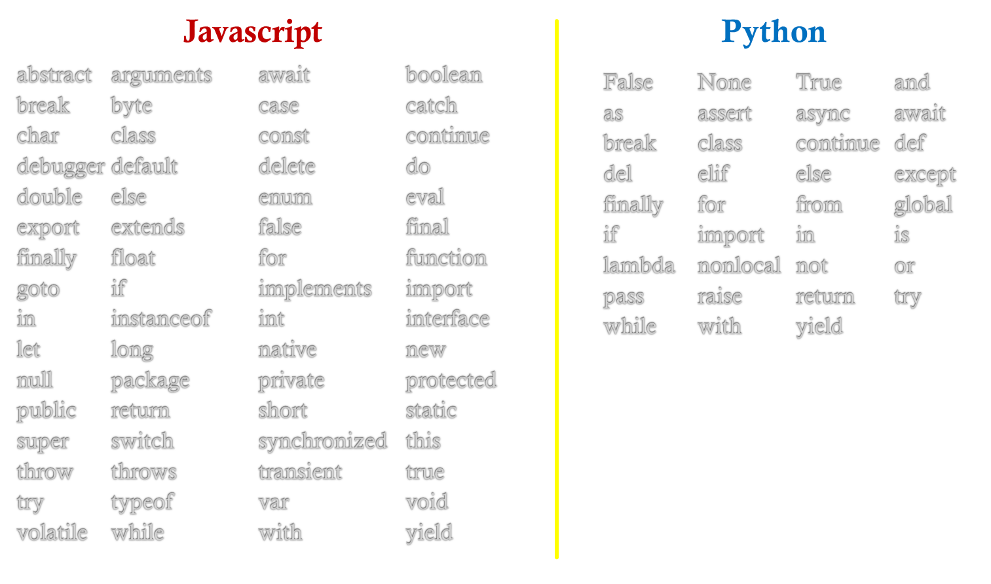
Keywords :

Slide 63
Features :
A “distinguishing characteristic of a software item (e.g., performance, portability, or functionality).”
Source: IEEE 829

Slide 64
Features :
A “distinguishing characteristic of a software item (e.g., performance, portability, or functionality).”
Source: IEEE 829

Slide 65
Features :
Data types (Strings, numbers, Objects, Date)
Loops (for, do, while, iterators)
Conditional statements
Boolean expressions
Collections (Array, Map, Set…)
Built-in functions
Import statements

Slide 66
Features :
Data types (Strings, numbers, Objects, Date)
Loops (for, do, while, iterators)
Conditional statements
Boolean expressions
Collections (Array, Map, Set…)
Built-in functions
Import statements

Slide 67
Libraries :
A “suite of data and programming code that is used to develop software programs and applications.”
Source: Techopedia.com

Slide 68
Libraries :
A “suite of data and programming code that is used to develop software programs and applications.”
Source: IEEE 829

Slide 69
Libraries :
Language (Strings, numbers, exceptions…)
Utilities (collections, formatting, datetime…)
I.O. (files, text, bytes, buffers…)
Cryptography (sha-256, hmac, public/private keys…)
Networking (URL, IPAddress, Socket's…)

Slide 70
Libraries :
Language (Strings, numbers, exceptions…)
Utilities (collections, formatting, datetime…)
I.O. (files, text, bytes, buffers…)
Cryptography (sha-256, hmac, public/private keys…)
Networking (URL, IPAddress, Socket's…)

Slide 71
Common abstract categories:
Syntax
Operators
Keywords
Features
Libraries

Slide 73
https://github.com/JonBoynton/JSConvert

